Slide 1
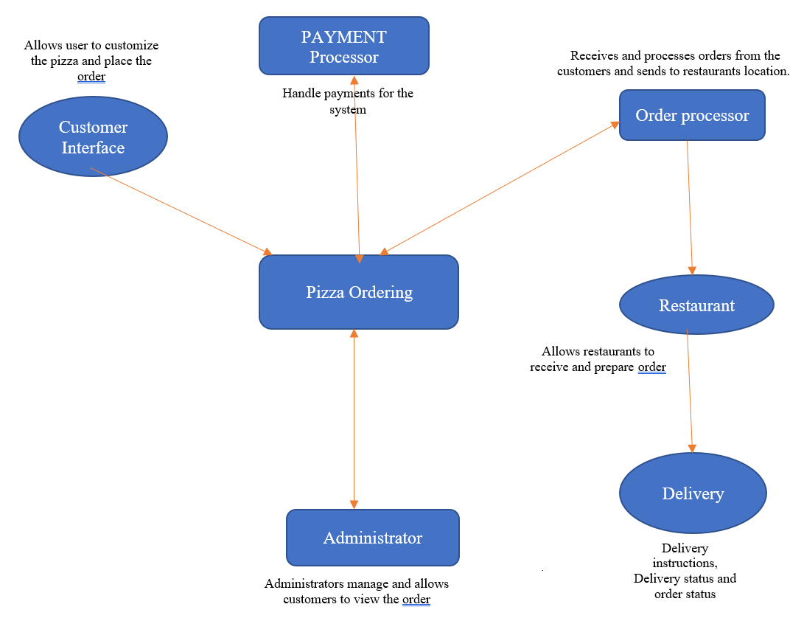
Circular Pie - Context Diagram

Slide 2

Circular Pie - Context Diagram
Business Management
Customer Success
5
Coordinate with various business stakeholders
Customer Support
3
Deliver Orders, Provide Delivery Tracking
Place Order, Make Payments, Track Order
Customer
Delivery Service Provider (Agents)
Circular Pie
1
Purchase Ad Banners
Process Payments
2
4
Receive, Track and
Update Order
Display Ads
Payment Gateway
Advertising & Sales Management
Partner Restaurants
Advertising Customer

Slide 3
System Interface Table
No | Description | Source | Target | Frequency | Validation
1 | Process Payments | Payment Gateway | Circular Pie | Real time | Validate order total, taxes and execute payments end to end, validate payments of returns
2 | Receive, track and update order | Partner Restaurants | Circular Pie | Real time | Validate orders, inventory and update order status
3 | Customer Support | Circular Pie | Customer Success | Real time | Handling queries and providing quick resolutions
4 | Display Ads | Advertising & Sales Management | Circular Pie | Real time | Display ads when customers visit the website
5 | Coordinate with various business stakeholders | Business Management | Circular Pie | Daily | Communicate with relevant stakeholders to maintain daily operations

Slide 4
System Interface Table
NO | DESCRIPTION | SOURCE | TARGET | FREQUENCY | VALIDATION
1 | Customer Interface | Personal information order details payment information | Order confirmation Payment confirmation | Real time | Validate that the customer's information is complete and accurate. Validate that the customer's location is within the delivery zone. Validate that the customer has selected a valid payment method.
2 | Administrator | Order data user data System logs and reports (sales, delivery reports) | Order management user management (add, delete restaurants) | Real time | validate that the administrator's login credentials are correct. Validate that the administrator has the necessary permissions to perform the requested action. Validate that the requested action is valid.

Slide 5
3 | Restaurant | Order data Inventory data (ingredients, supplies) Delivery status updates | Order management Inventory management Delivery Management | Real time | Validate that the restaurant has received the correct order information. Validate that the restaurant has the necessary inventory to fulfill the order. Validate that the requested order is valid.
4 | Order Processor | Order data (order number,.) inventory data Delivery updates | Order processing Inventory Management. Delivery Management | Real time | Validate that the order information is complete and accurate. Validate that the order can be fulfilled within the requested time frame. Validate that the requested order is valid.

Slide 6
5 | Payment Processor | Payment information (credit card number, billing address) Transition data (Transaction ID, Amount, data and time) | Payment processing (Process and verify payments, provide transaction status updates) Refund processing (process refunds) | Payment process | Validate that the payment information is complete and accurate. Validate that the payment method is valid and accepted by the website. Validate that the payment can be processed successfully.
6 | Delivery | Delivery instruction order data Delivery status updates | Order pick-up and delivery Customer service | Real Time | Validate that the delivery address is complete and accurate. Validate that the delivery can be made within the requested timeframe. Validate that the requested delivery is valid.

